Slide 1
Lead Scoring
By Mayak Noel and Nitin Jayan

Slide 2
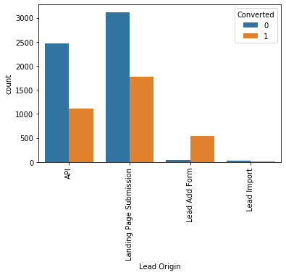
Leads by Origin
One may observe that the quantity of leads are highest for Landing Page Submission followed by API.
The quality of leads however is higher for Lead Add Forms as evidenced by the conversion rates.
Perhaps, X education could tweak its marketing process to include more forms or navigate prospects through forms.

Slide 3
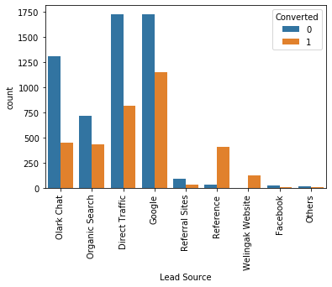
Leads by Source
One may observe that reference produces the highest quality of leads. X Education could therefore invest more in Customer Success/Service which increases the likelihood of more references.
Olark Chat, Organic Search, Direct Traffic and Google yields a lot of leads but conversion is quite low.

Slide 4
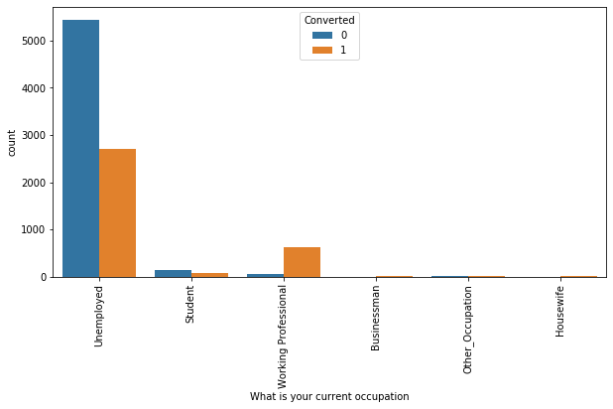
Leads by Occupation
Most number of leads come from unemployed people. To increase conversion, perhaps easy financing options could be put in place.
Working professional look to have a high conversion rate but low number of leads. X Education can target this demographic more.

Slide 5
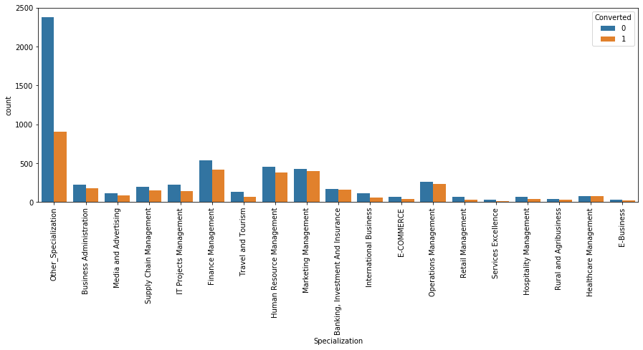
Leads by Specialization
“Other” Specializations make up a large proportion of leads.

Slide 6
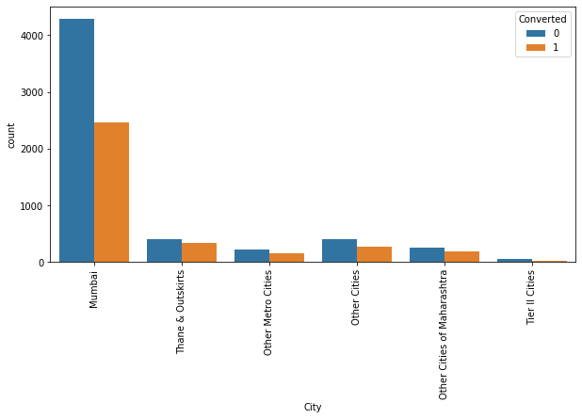
Leads by Cities
Most number of leads are from Mumbai.
It would beneficial for X Education to get to the reason behind the high volume of leads from here. Ex: Location, More marketing here etc

Slide 7
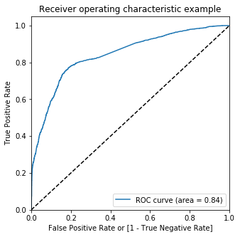
ROC Curve

Slide 8
KEY TAKEAWAYS FROM THE MODEL
Model Building
Firstly, RFE was done to attain the top 15 relevant variables. Later the rest of the variables were removed manually depending on the VIF values and p-value (The variables with VIF < 10 and p-value < 0.05 were kept). We then performed some iteration to identify the best model by removing variables and reached to a final model.
Evaluation of Model
A confusion matrix was made. Later, the optimum cut off value (using ROC curve) was used to find the accuracy, sensitivity and specificity which came to be around 79%, 77% and 80% respectively. Prediction
Prediction was done on the test data frame and with an optimum cut off as 0.3 with accuracy, sensitivity and specificity of 79%, 77% and 80% respectively.

Slide 9
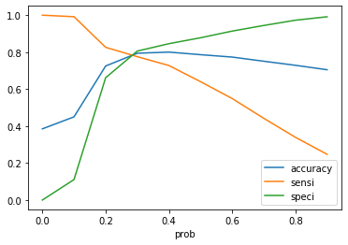
CUT – OFF :

Slide 10
Conclusion:
The Accuracy, Precision and Recall score we got from test set in aceptable range.
We have high recall score than precision score which we were exactly looking for.
In regard to business perspective, this can be remodelled with the company’s requirements in coming future.
The final columns considerable for evaluation and modeling :
- What is your current occupation_Unemployed - Lead Origin_Landing Page Submission
- Specialization_Other_Specialization - Lead Source_Olark Chat
- Lead Origin_Lead Add Form - Lead Source_Welingak Website
- Total Time Spent on Website - What is your current occupation_Student
- Do Not Email - What is your current occupation_Other_Occupation

